Slide 1

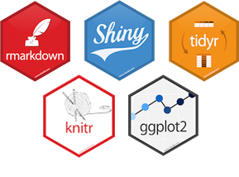



Interactive plotting with ggplot and shiny in Galaxy
by Jochen Bick

Slide 2
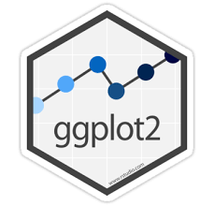
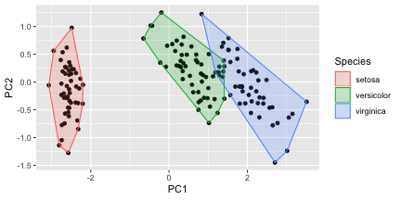
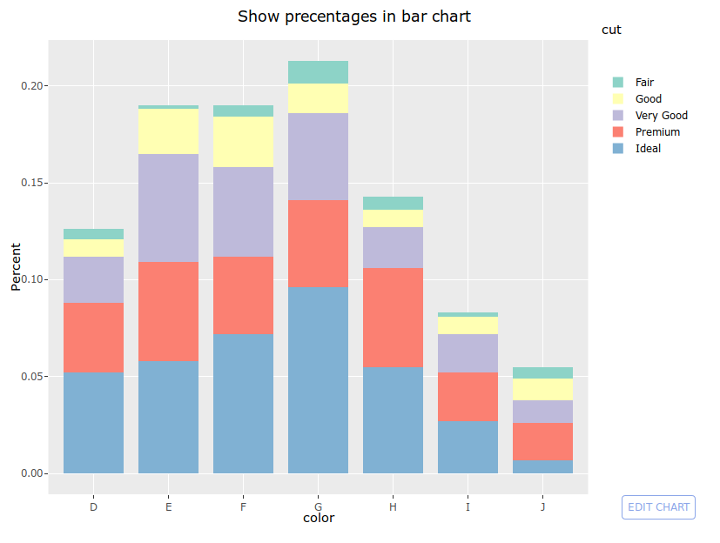

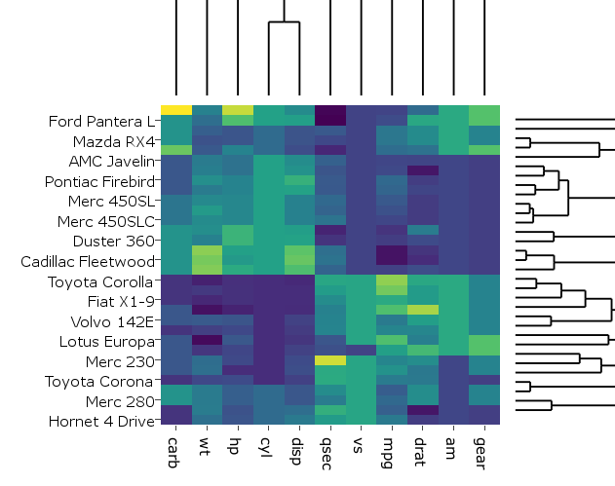
The idea
change existing ggplot2 galaxy tools and make them interactive
use shiny and/or plotly for the implementation
add more plots available with ggplot2
barplot
violine
PCA
heatmap
...

Slide 3
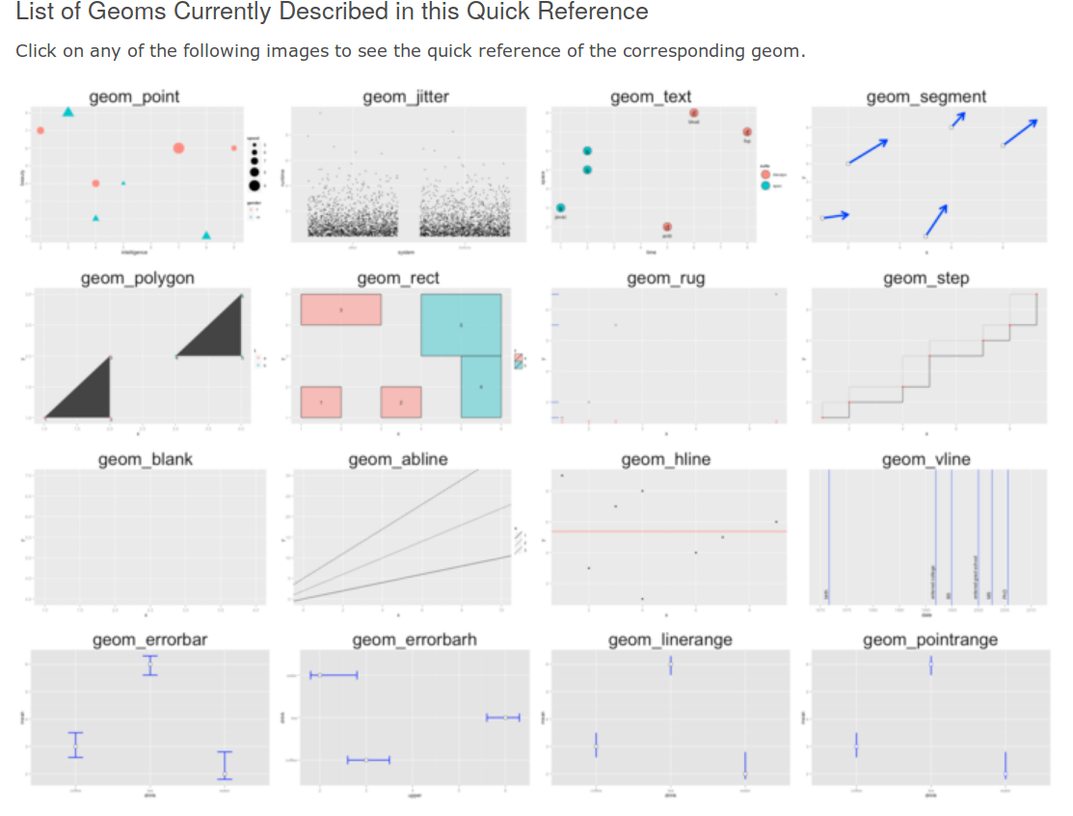
more plot types
there are many more options for plots with geom_* available.
not all of them are frequently used
http://sape.inf.usi.ch/quick-reference/ggplot2/geom

Slide 4
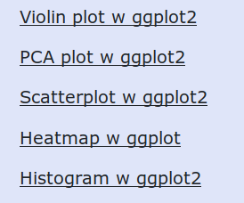
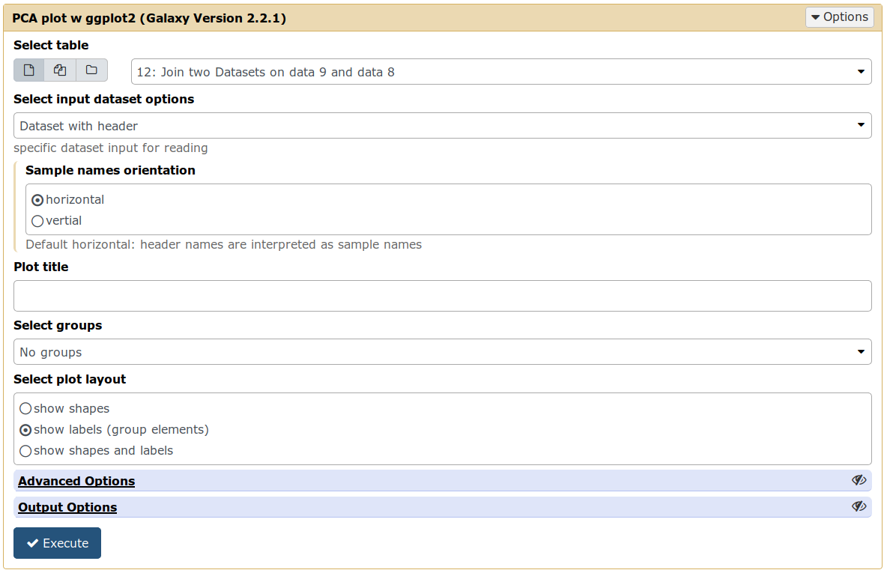
Existing ggplot2 Galaxy apps

Slide 5
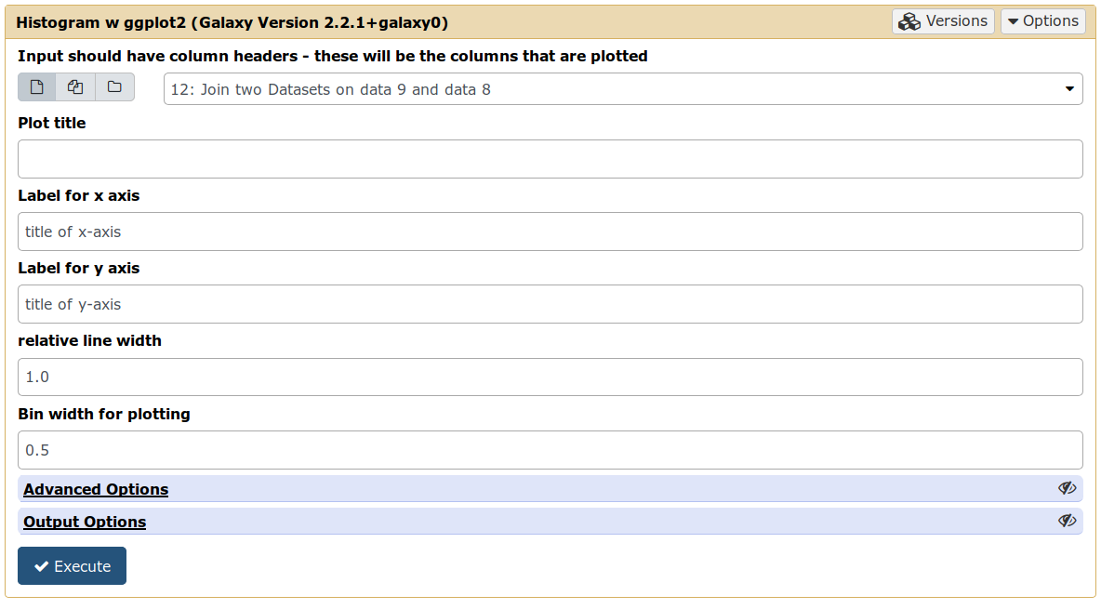
Existing ggplot2 Galaxy apps

Slide 6
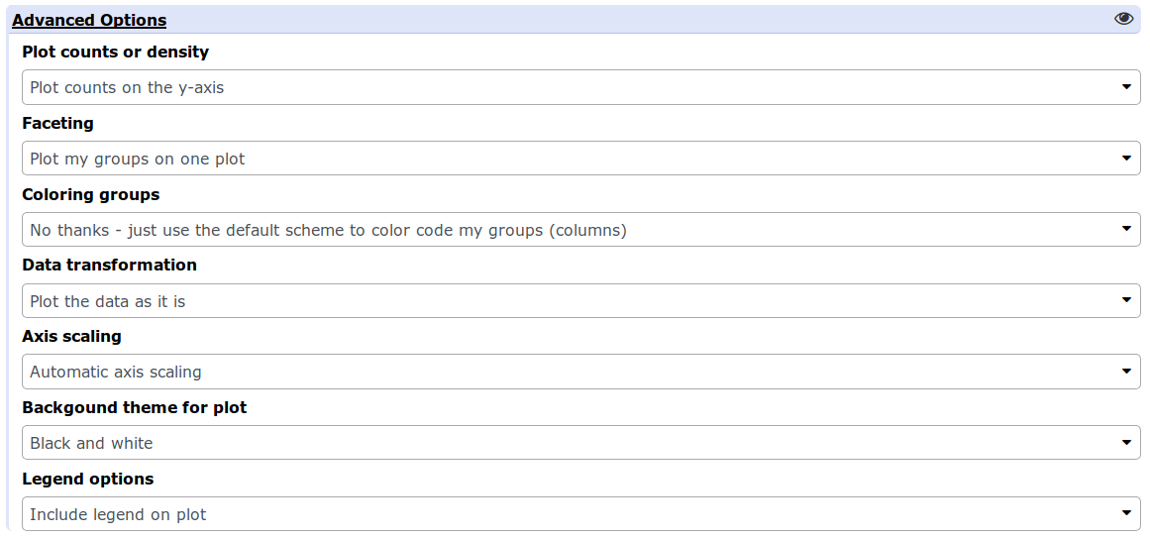
Existing ggplot2 Galaxy apps

Slide 7
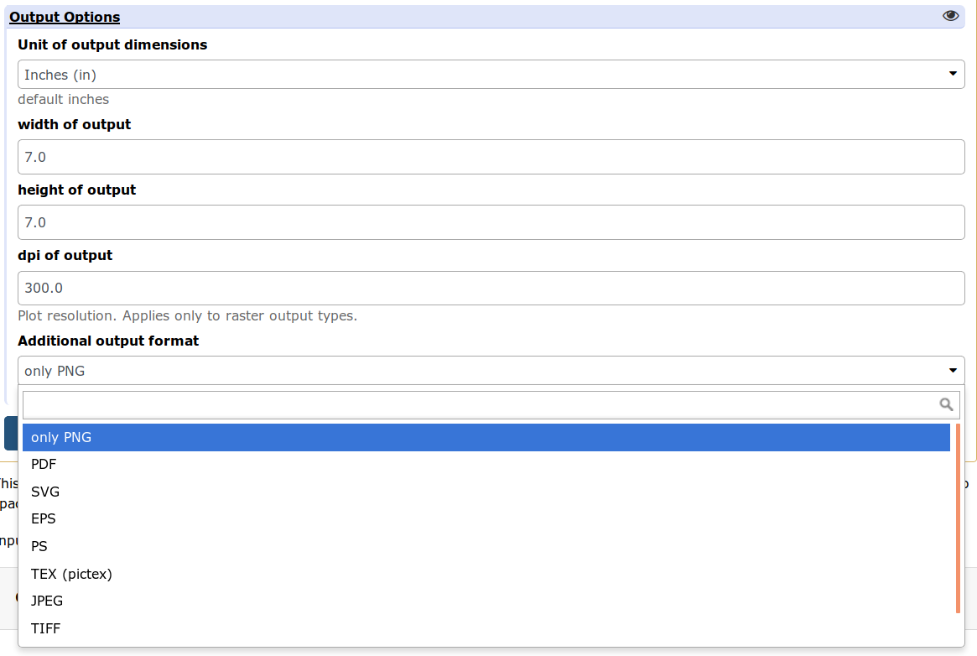
Existing ggplot2 Galaxy apps

Slide 8
DEMO
with RStudio
adapted from: https://github.com/JoachimGoedhart/PlotsOfData

Slide 9
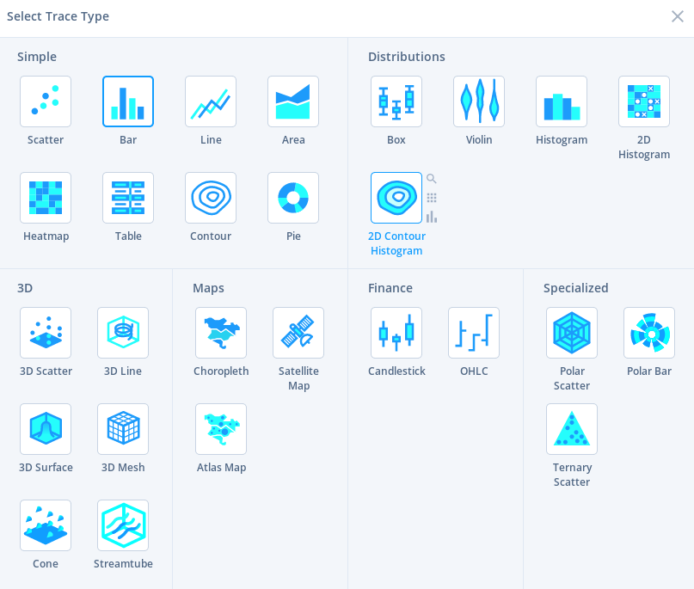
Outlook
use features from plot.ly
connect shiny app with Galaxy
add more plot option to provide useful plots
https://plot.ly/

